Slide 1


NeuroForge Nexus
Enterprise Software Lifecycle and DevOps Management System

Slide 2






Introduction
What We Built
The Problem It Solves
How It Helps
NeuroForge Nexus is an all-in-one centralized workspace designed to help software teams manage their entire development process from start to finish.
Instead of teams juggling multiple different tools for planning tasks, testing code, and launching products, our platform brings everything together into a single, unified dashboard.
It creates a smooth, automated pipeline where managers can track team progress, developers can safely test their code, and operations teams can monitor the live application’s health without missing a beat.

Slide 3



Project Overview
Secure Access Management
Administrator Role (Full Control)
Team Member Roles (Restricted Access)
The platform uses a strict Role-Based Access Control (RBAC) system powered by Keycloak to ensure everyone has the right level of access to the workspace.
Admins and Project Manager act as the controllers of the platform. They have the exclusive authority to create new projects, build teams, assign specific people to those teams, and make global edits to the system settings.
Other roles have tailored, restricted access. They cannot alter team structures or edit core project settings.

Slide 4






Core Platform Features
Secure Identity & Access
Agile Tracking & Event Streaming
Automated CI/CD Pipelines
Powered by Keycloak for strict Role-Based Access Control (RBAC) across Admin, PM, Dev, and QA roles.
Integrates Jenkins and GitHub Actions for seamless build and deployment tracking, achieving a 97.4% success rate and rapid 4.2-minute deploys.
Features interactive Kanban boards with a 94% burndown success rate, backed by Apache Kafka for real-time task notifications.
DevOps Observability
Advanced Release Management
AI-Powered Assistance
Utilizes Prometheus, Grafana, and the ELK Stack to continuously monitor service health, CPU, and memory usage.
Features an integrated Groq AI Assistant directly within the dashboard to provide smart insights and streamline platform workflows.
Supports Blue-Green deployments and instant rollback capabilities to maintain a lightning-fast 12-minute MTTR (Mean Time To Recovery).

Slide 5
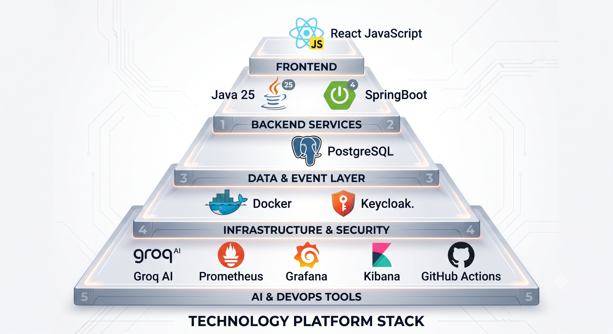
Technology Stack & Architecture
Frontend | React, JavaScript
Backend Services | Java 25, Spring Boot 4
Data & Event Layer | PostgreSQL
Infrastructure & Security | Docker, Keycloak.
AI & DevOps Tools | Groq AI, Prometheus, Grafana, Kibana, and GitHub Actions

Slide 6
Project Milestones
Milestone 1 (Weeks 1-2)
Milestone 2 (Weeks 3-4)
Milestone 3 (Weeks 5-6)
Milestone 4 (Weeks 7-8)
Project & User Management (Implementing RBAC, Keycloak IAM, and Team Setup).
Sprint & Task Management (Deploying Kanban boards, velocity tracking, and blocker management).
CI/CD Pipeline (Integrating Jenkins, tracking builds, test results, and deployment status).
Release & Monitoring (Deploying DevOps observability, alert management, and log analysis).

Slide 7
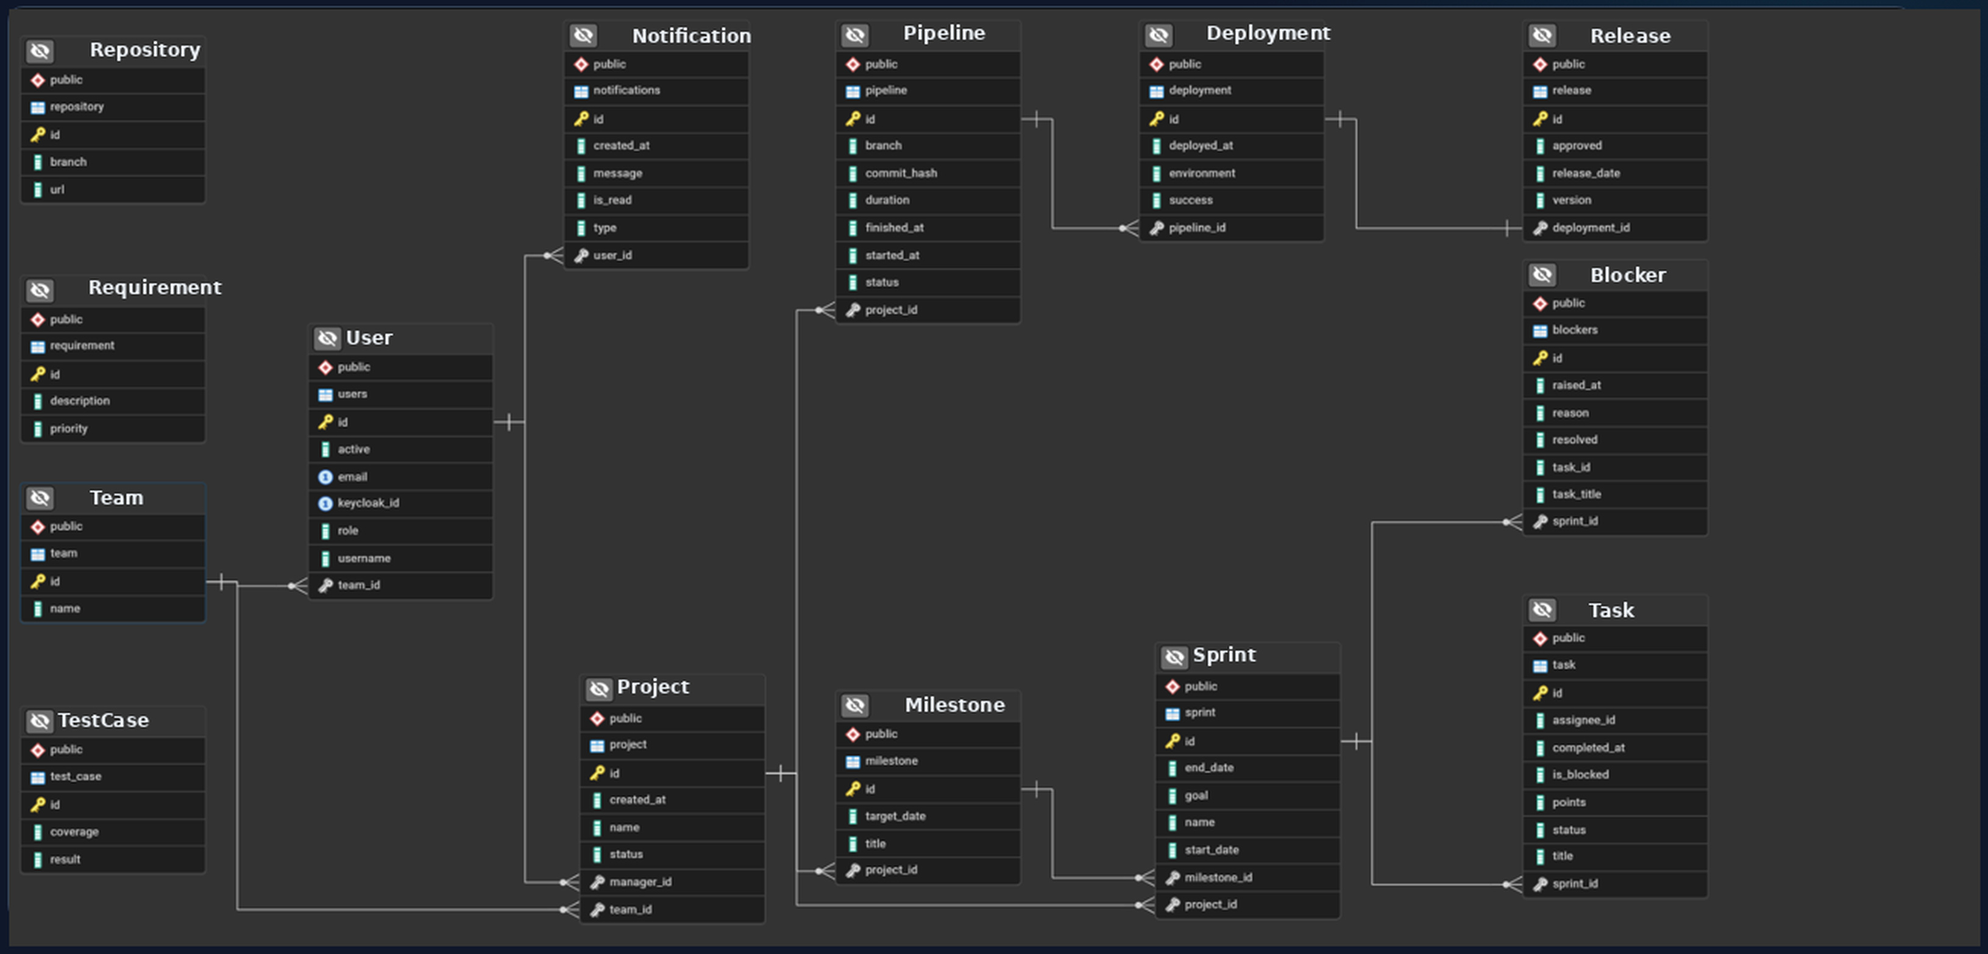
Class diagram

Slide 8
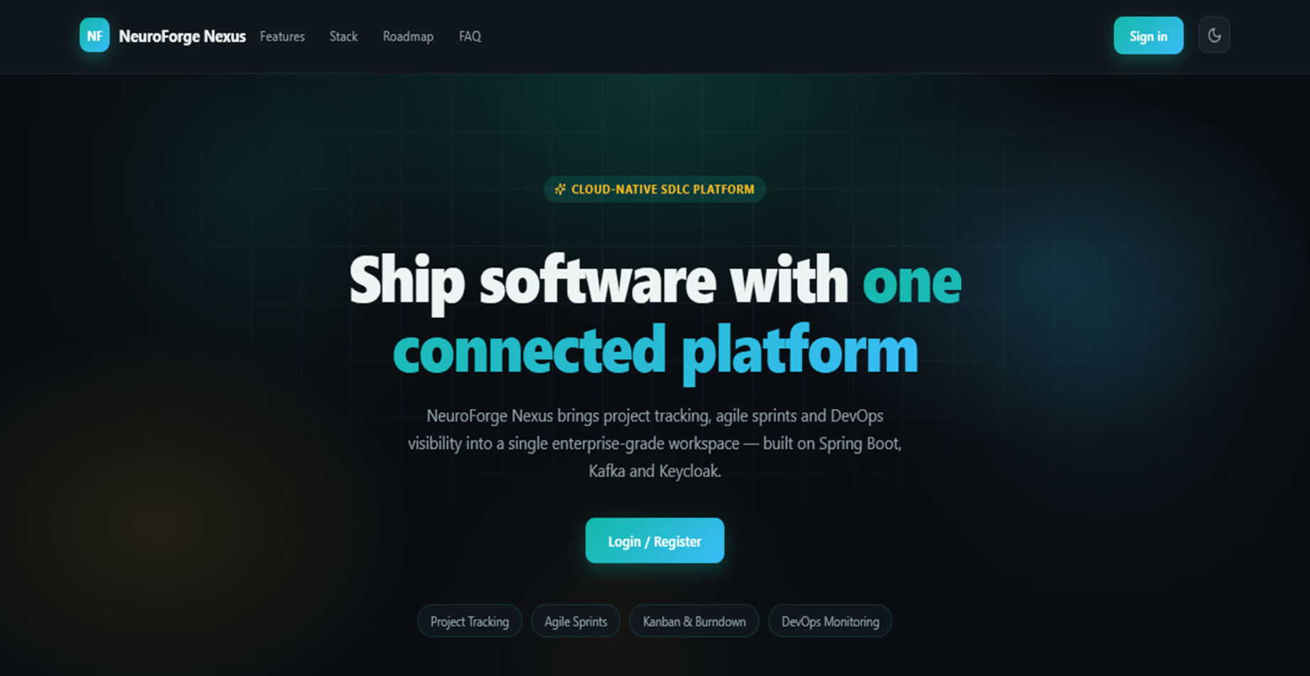

Slide 9


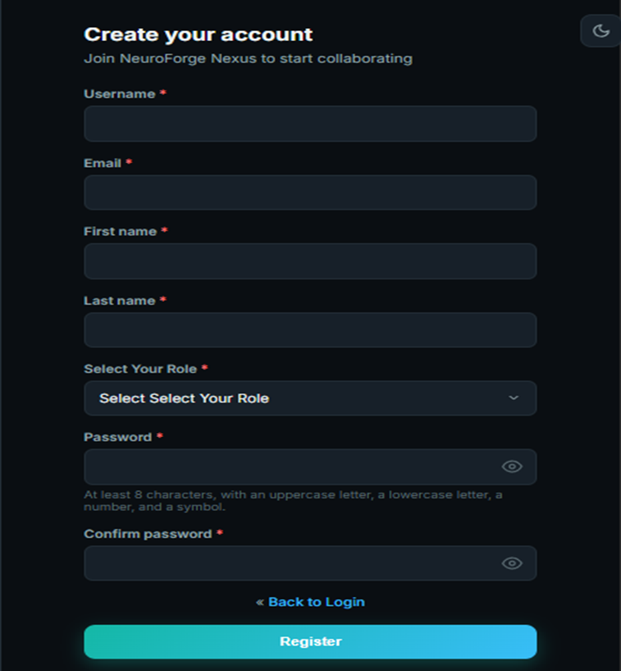

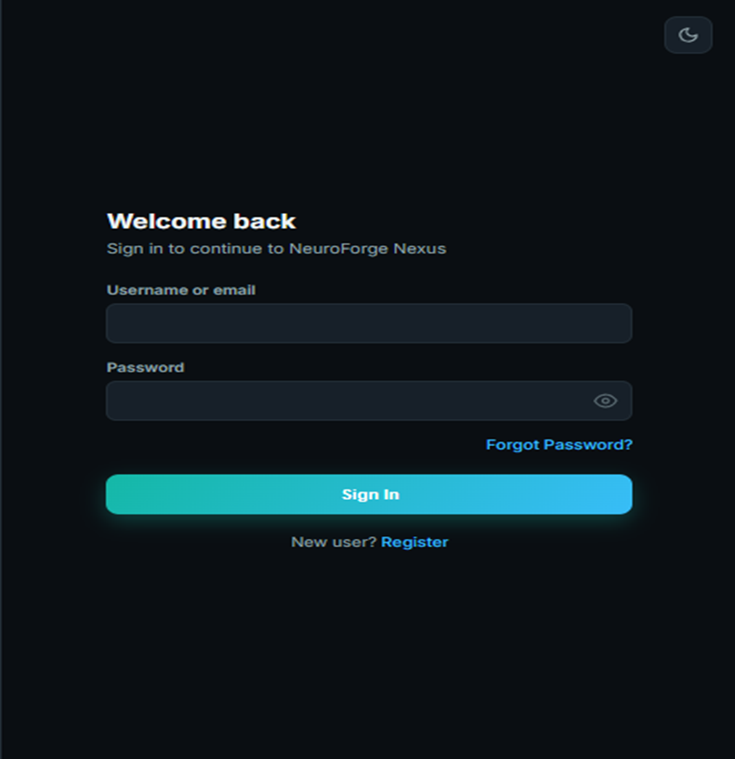

Register & Login

Slide 10
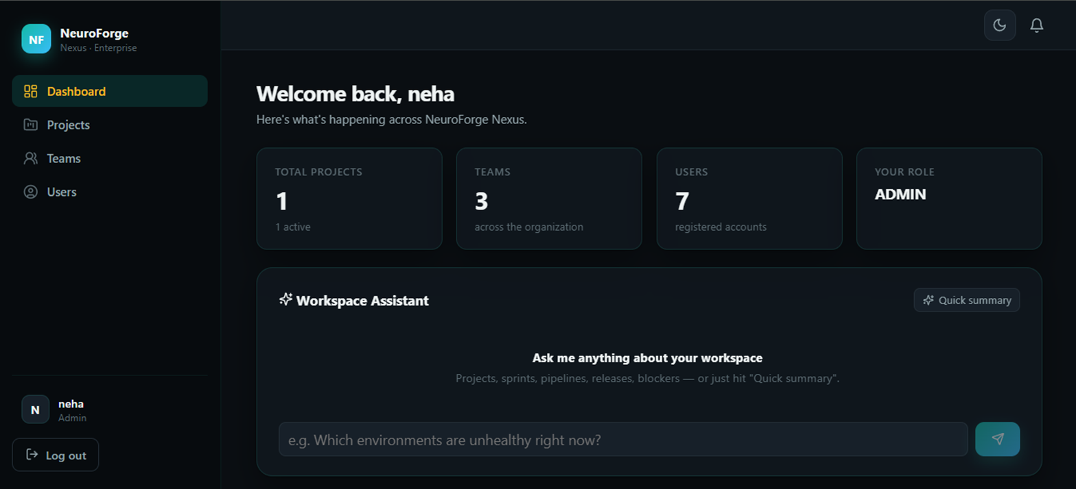


Dashboard
Centralized Project Dashboard: Managing active projects, teams, status updates, and granular project settings from a unified command center.

Slide 11
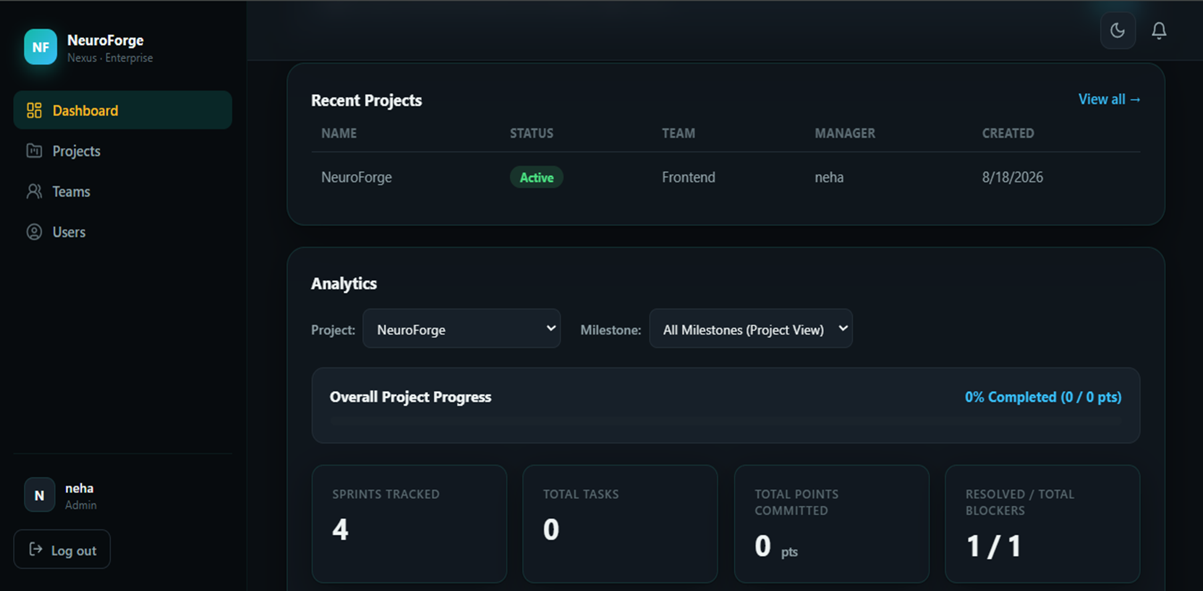

Slide 12
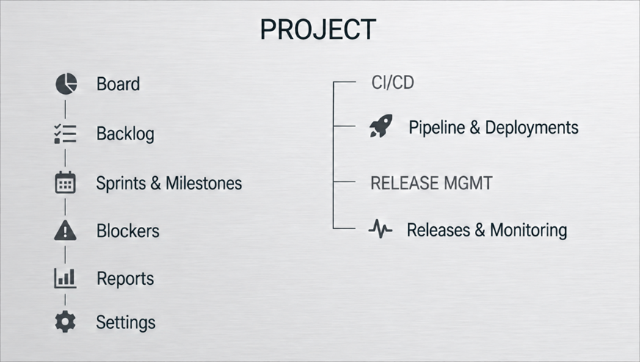
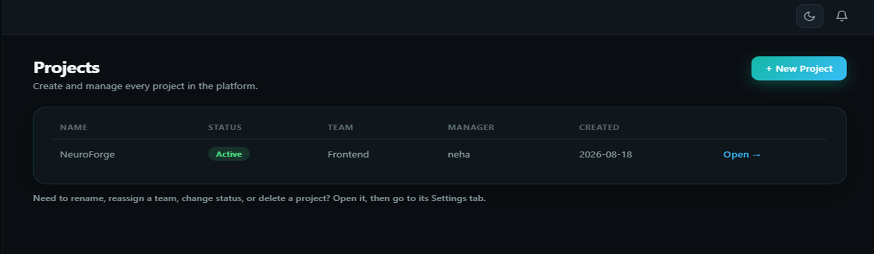
Project

Slide 13
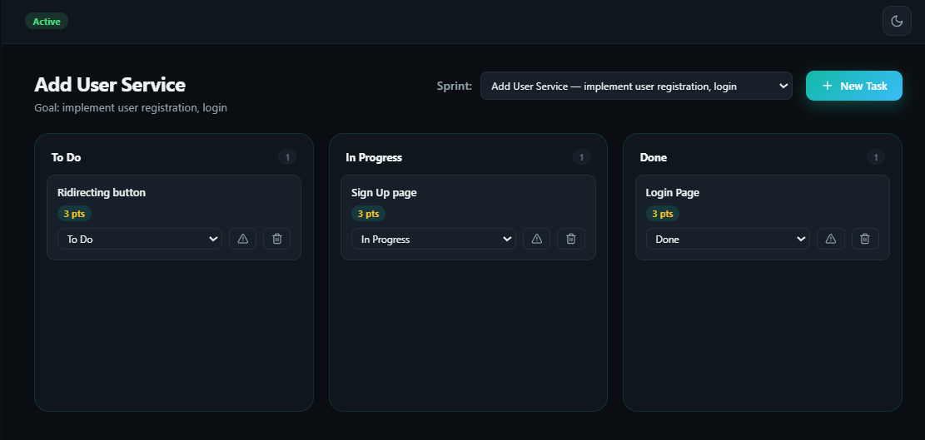
Kanban Board
Interactive Agile Kanban Board: Streamlining sprint workflows with dynamic task creation, story point estimation, and real-time lifecycle tracking.

Slide 14
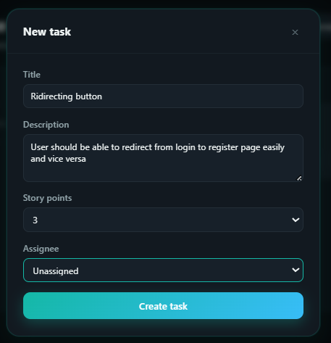
Kanban Board

Slide 15
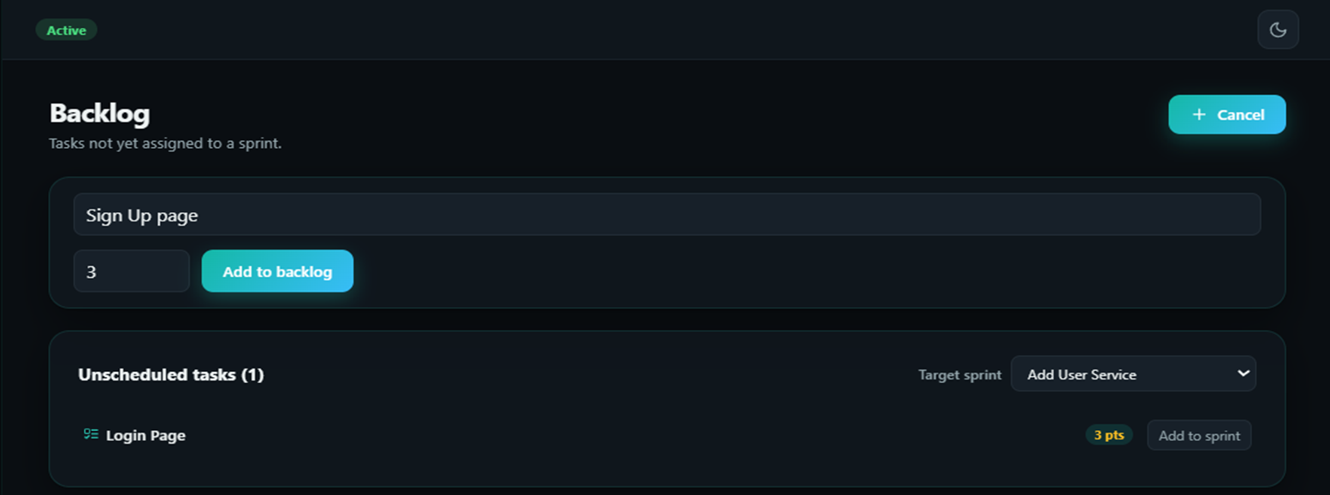
Backlog
Product Backlog Management: Seamlessly organize unscheduled tasks and assign them directly to active sprints for automated synchronization with the Kanban board.

Slide 16
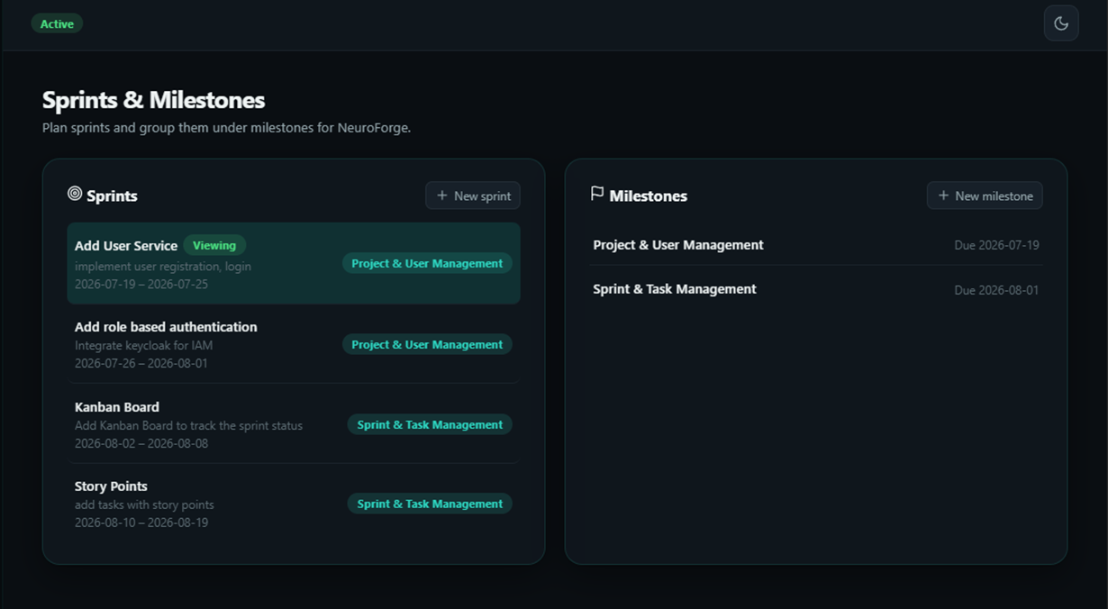
Sprints & Milestones
Sprints & Milestones Management: Grouping iterative sprint cycles under structured milestones to maintain a clear roadmap and track target deadlines effectively.

Slide 17




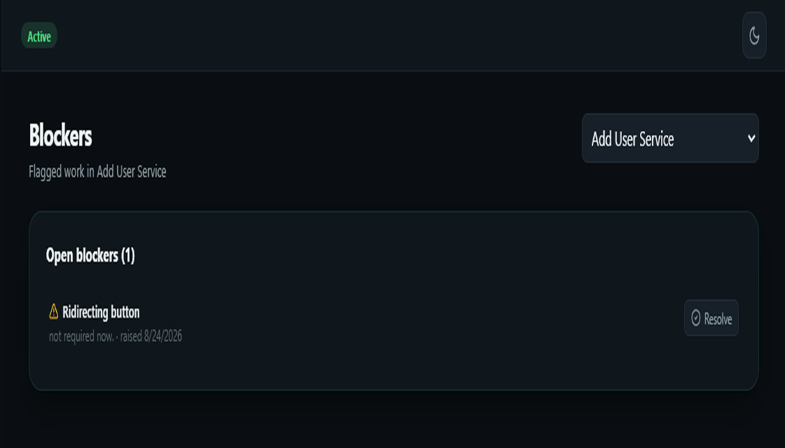
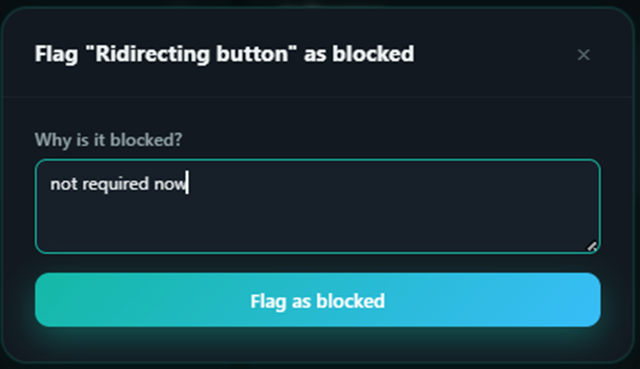
Blockers
Blockers Management: Flagging critical bottlenecks to halt workflow operations and route issues to a dedicated resolution queue until cleared.

Slide 18
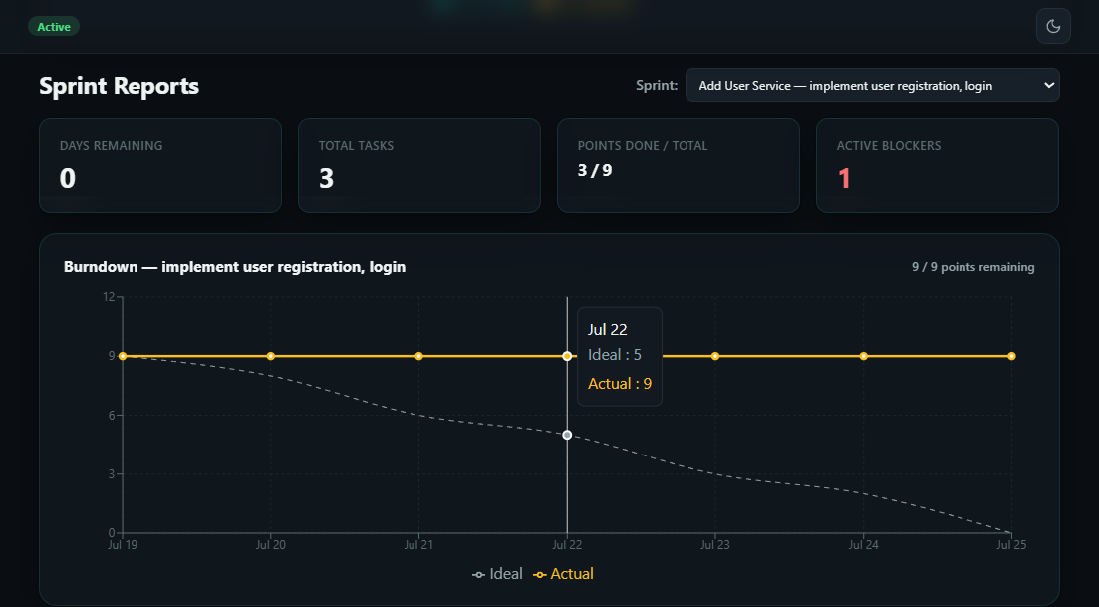
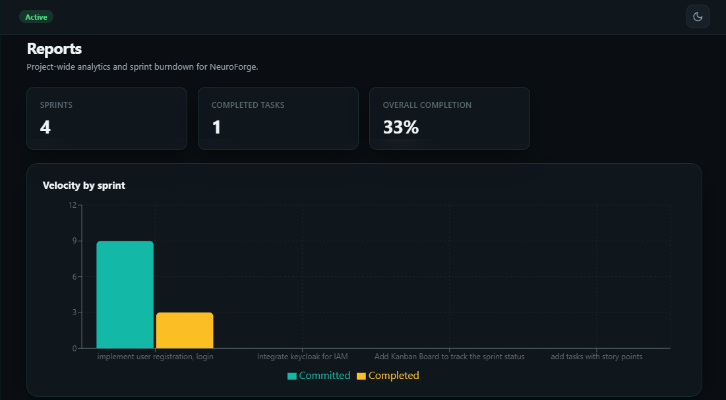
Reports
Sprint Analytics & Burndown: Tracking velocity, committed vs. completed story points, and daily burn-down progress to monitor project health in real-time.

Slide 19
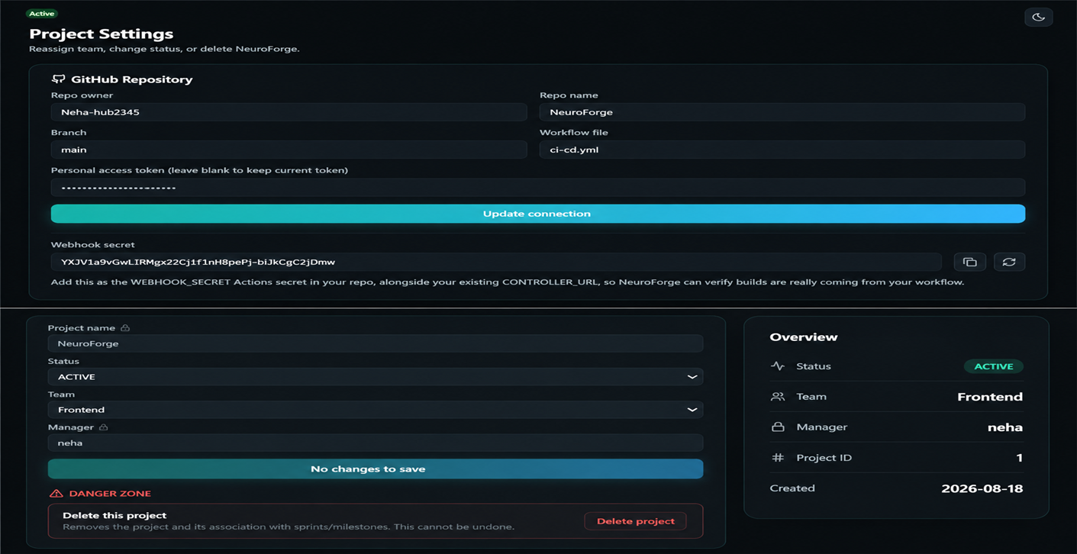
Settings
GitHub Integration & Project Settings: Linking remote repositories with secure webhooks and personal access tokens to power automated CI/CD workflows and manage granular project configurations.

Slide 20
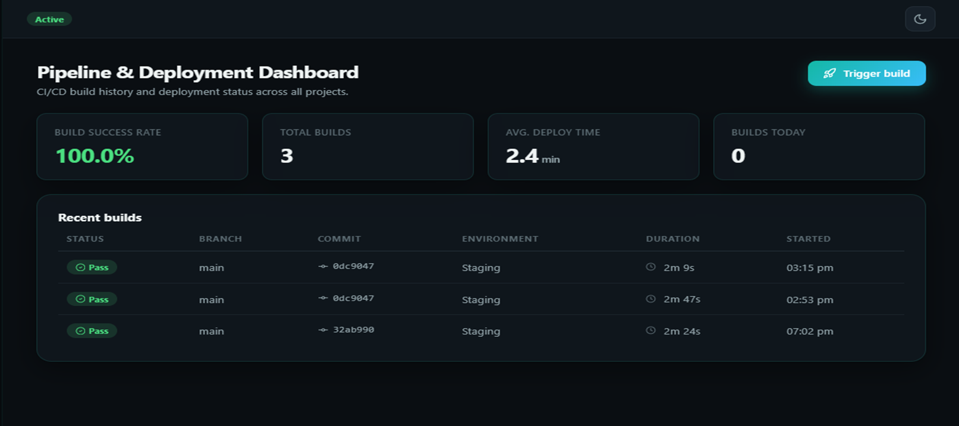
Pipelines & Deployements
CI/CD Pipeline & Deployment Dashboard: Automatically trigger builds and monitor real-time build histories, commit branches, and deployment metrics across environments.

Slide 21
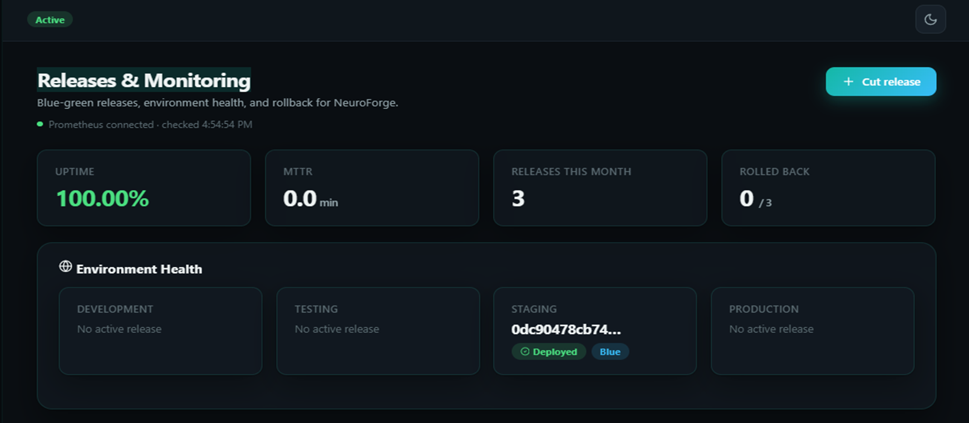
Release & Monitoring
Release History & Blue-Green Deployments: Managing environment slots, tracking release versions, and maintaining zero-downtime deployment visibility.

Slide 22
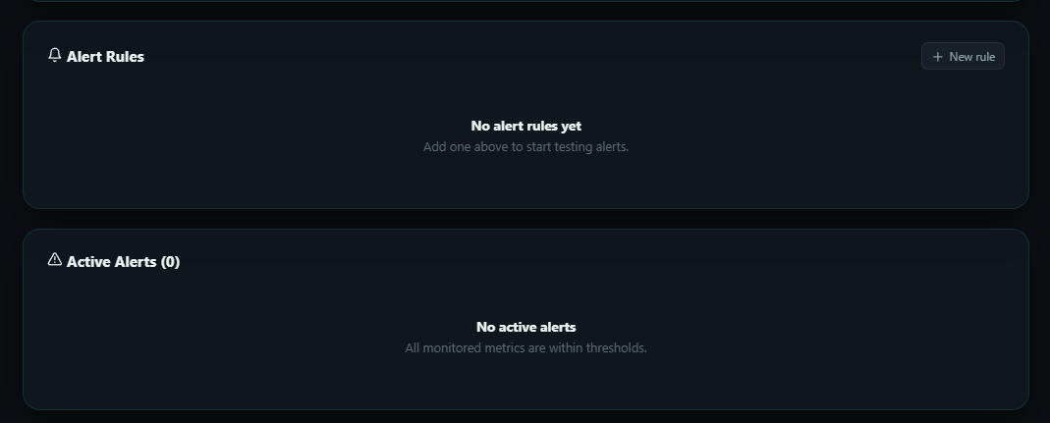
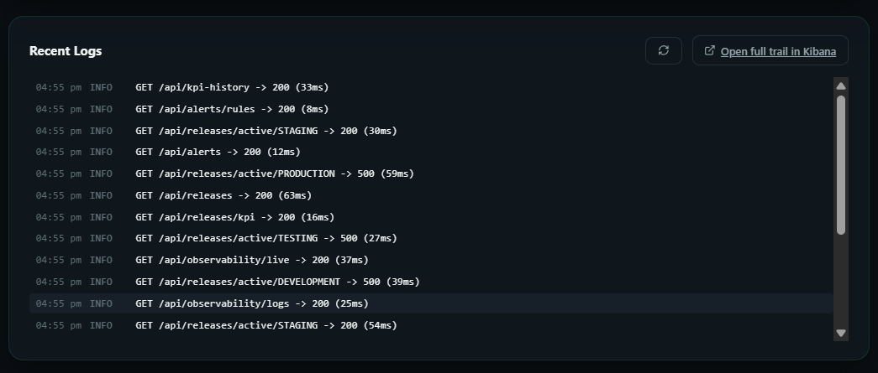
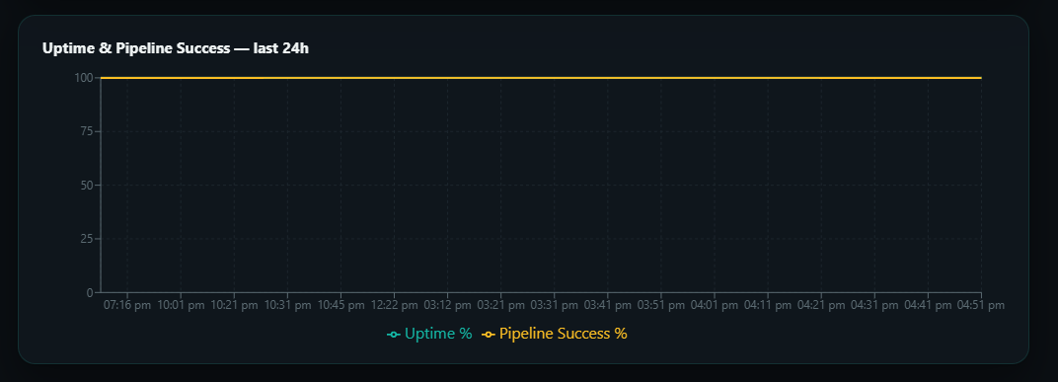
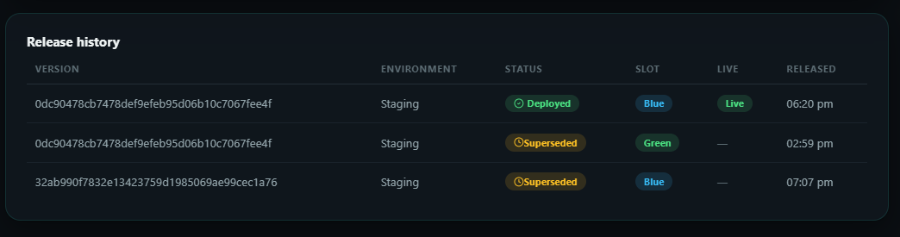
Release & Monitoring

Slide 23
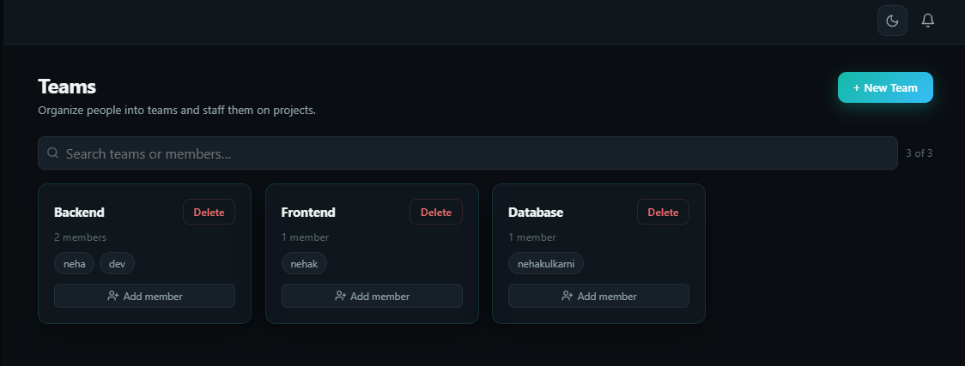
Teams
Team Management & Staffing: Organizing registered platform users into specialized teams like Backend, Frontend, and Database to streamline project assignments.

Slide 24
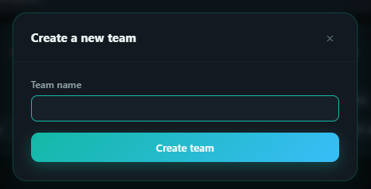
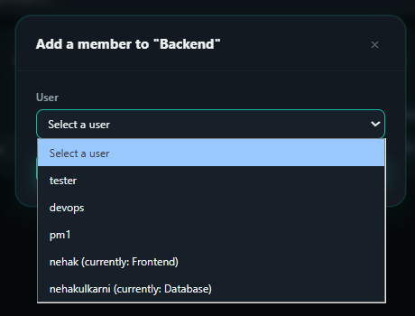
Teams

Slide 25
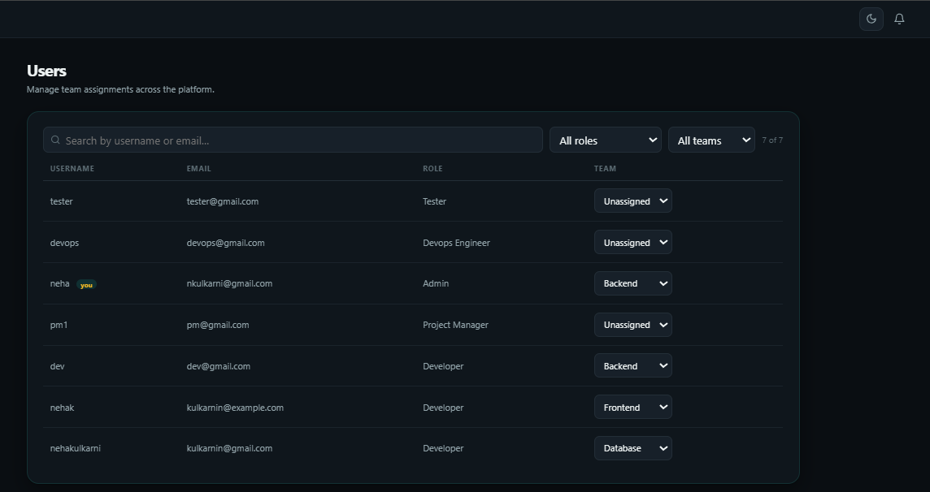
Users
User Management & Role Assignment: Centralized directory allowing administrators and project managers to view registered accounts, filter by roles, and manage team allocations dynamically.

Slide 26
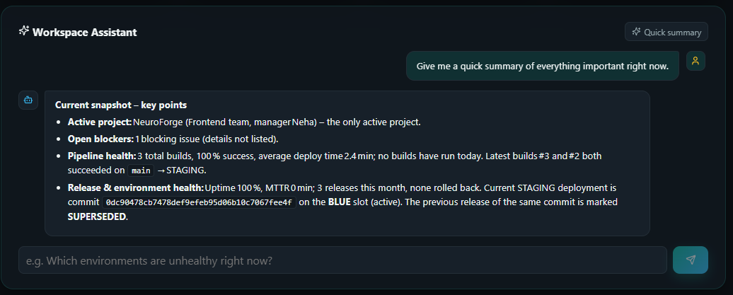
AI Assistant
Groq AI Workspace Assistant: Integrated intelligence providing instant project summaries, pipeline health checks, and real-time environment insights.

Slide 27
Challenges Faced
Milestone1: Keycloak Security
Issue: Syncing JWT sessions securely with the Spring Boot backend.
Fix: Mapped Keycloak claims directly to PostgreSQL for real-time RBAC validation.
Milestone2:React Frontend State
Issue: UI lag during Kanban board drag-and-drop operations.
Fix: Optimized React state management to prevent excessive re-rendering.
Milestone3:GitHub Actions CI/CD
Issue: Securily triggering webhook from a local development setup.
Fix: Implemented secure ngrok tunneling and strict wehook secret verification.
Milestone4:Promethues and Grafana
Issue: Monitoring tools consuming too much system RAM.
Fix: Capped Docker resource limits and optimized metric scraping intervals.

Slide 28






Team Members

Slide 29
Thank You

